Slide 1
Unit – 1
Introduction to number systems and logic gates

Slide 2
Number systems – binary, decimal, octal, hexadecimal; codes – grey, BCD, excess – 3, ASCII, parity, binary arithmetic – addition, subtraction, multiplication, division using sign magnitude, 1’s complement, 2’s complement, BCD arithmetic, logic gates – AND, OR, NOT, NAND, NOR, EX-OR, EX-NOR

Slide 3
Computer architecture
Attributes of a system visible to a programmer/those attributes that have a direct impact on the logical execution of a program.
Attributes:
Instruction set.
No. of bits to represent various data types.
I/O mechanisms.
Techniques for addressing memory.

Slide 4
Computer
Complex systems.
Millions of elementary electronic components.
Fast electronic calculating machine, accepts digitized input information, process the internally stored instructions and produces result.

Slide 5
Computer
Computer program – list of instructions.
Memory – internal storage.
Personal computer – common type.
Notebook computers – a compact version of the personal computer with all of the components packed into a single unit.
Workstations – high resolution graphics, input or output
Retains the resolution of desktop computers.
More computational power.
Used in engineering applications.

Slide 6
Computer
Servers – sizable database storage units.
Handles large volumes of request to access the data.
Super computer – used for large scale numerical calculations.

Slide 7
Functional unit
5 independent parts:
Input
Memory
ALU
Output
Control units

Slide 8
Input
ALU
Memory
Output
Control
Input / Output
Processor

Slide 9
Instructions/machine instructions:
Explicit commands that,
Govern the transfer information within the computer as well as between computer and its I/O devices.
Specify the arithmetic and logic operations to be performed.
Program list of instructions that perform a task.
Data: number and encoded characters used as operands.
Compiler: task of compiling high level source program into machine instructions.
Bits: binary digits
ON/OFF – 1/0

Slide 10
Number systems
To express/represent numbers.
Decimal number system is the most commonly used – base 10.
Number systems in computer include,
Binary – base 2
Octal – base 8
Hexadecimal – base 16

Slide 11
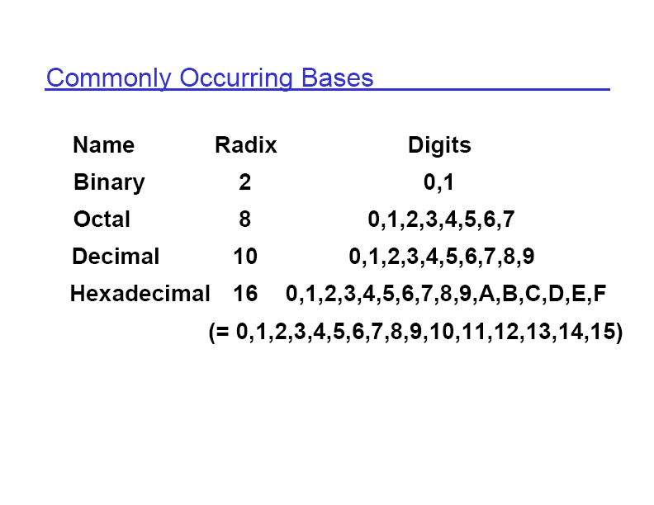

Slide 12
Decimal number system
Base – 10
It represents numeric value with 10 digits.
Any number to decimal conversion:
Multiply each digit by its own base power the position.

Slide 13
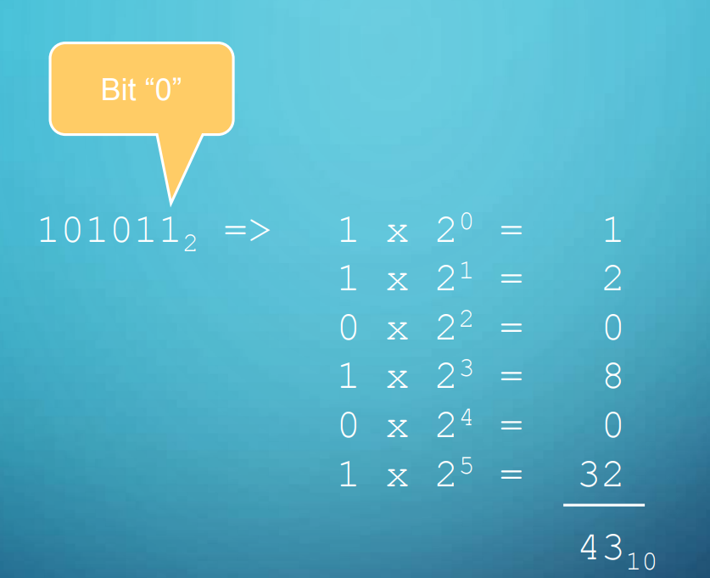
Binary to decimal conversion
Multiply each digit by 2^n, where n is the position.

Slide 14
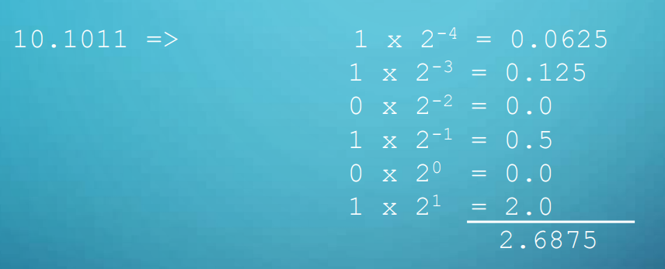
Binary to decimal conversion
Fractional conversion

Slide 15
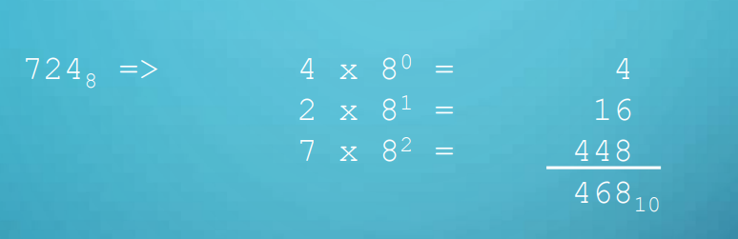
Octal to decimal conversion

Slide 16
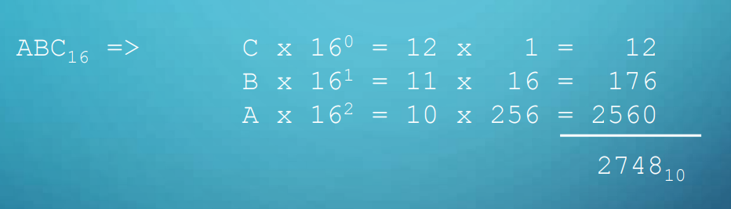
Hexadecimal to decimal conversion

Slide 17

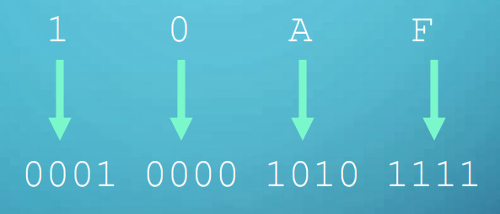

Hexadecimal to binary conversion
Convert each hexadecimal digit to its equivalent binary.

Slide 18

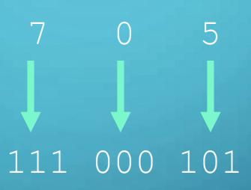

Octal to binary conversion
Convert each digit to its equivalent 3 bit binary.

Slide 19
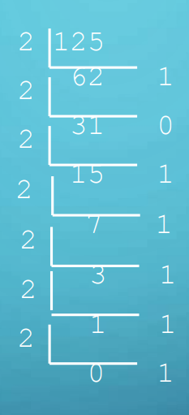


Decimal to binary conversion
Divide the number by 2, keep track of the reminder.

Slide 20
Decimal to binary conversion
Divide the number by 2, keep track of the reminder.

Slide 21

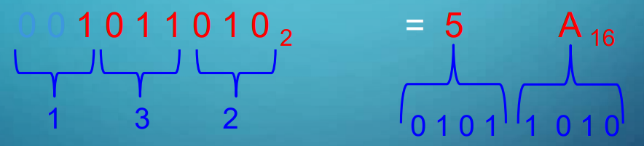
Octal to hexadecimal conversion
Octal - > binary -> hexadecimal

Slide 22
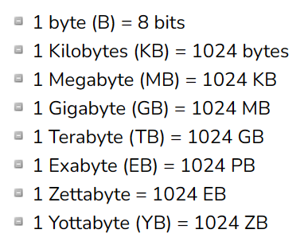
Memory size

Slide 23
Codes
Gray code:
Used to reduce the occurrence of errors.
Only one bit is changed at a time.

Slide 24
Codes (Gray code)
Decimal Number | Binary Number | Gray Code
0 | 0000 | 0000
1 | 0001 | 0001
2 | 0010 | 0011
3 | 0011 | 0010
4 | 0100 | 0110
5 | 0101 | 0111
6 | 0110 | 0101
7 | 0111 | 0100
8 | 1000 | 1100
9 | 1001 | 1101
10 | 1010 | 1111
11 | 1011 | 1110
12 | 1100 | 1010
13 | 1101 | 1011
14 | 1110 | 1001
15 | 1111 | 1000

Slide 25

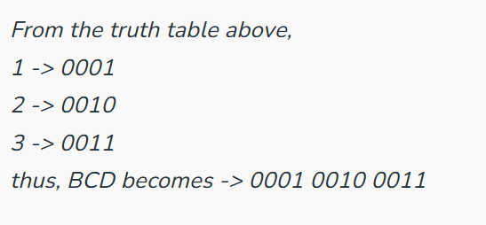

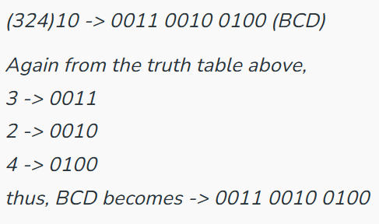
Binary coded decimal
Coding is done in 8 – bit / 4 – bit.

Slide 26
Excess – 3 code
Overcomes the deficiency in BCD code.
Decimal Digit | BCD Code | Excess-3 Code
0 | 0000 | 0011
1 | 0001 | 0100
2 | 0010 | 0101
3 | 0011 | 0110
4 | 0100 | 0111
5 | 0101 | 1000
6 | 0110 | 1001
7 | 0111 | 1010
8 | 1000 | 1011
9 | 1001 | 1100

Slide 27
Excess – 3 code
31
Digit | BCD
3 | 0011
1 | 0001
Decimal | BCD | Excess-3
3 | 0011+0011 | 0110
1 | 0001+0011 | 0100

Slide 28
Excess – 3 code
81.61
So, the excess-3 code of the decimal number 81.61 is 1011 0100.1001 0100
Digit | BCD
8 | 1000
1 | 0001
6 | 0110
1 | 0001
Decimal | BCD | Excess-3
8 | 1000+0011 | 1011
1 | 0001+0011 | 0100
6 | 0110+0011 | 1001

Slide 29
Excess – 3 code
81.61
So, the excess-3 code of the decimal number 81.61 is 1011 0100.1001 0100
Digit | BCD
8 | 1000
1 | 0001
6 | 0110
1 | 0001
Decimal | BCD | Excess-3
8 | 1000+0011 | 1011
1 | 0001+0011 | 0100
6 | 0110+0011 | 1001

Slide 30
ASCII code
ASCII – American Standard Code for Information Interchange.
Standard character set for computers and electronic devices, developed in 1960s.
Contains 128 characters.
It contains the numbers from 0-9, the upper and lower case English letters from A to Z, and some special characters.
The character sets used in modern computers, in HTML, and on the Internet, are all based on ASCII.

Slide 31
Char | Number | Description
NUL | 00 | null character
SOH | 01 | start of header
STX | 02 | start of text
ETX | 03 | end of text
EOT | 04 | end of transmission
ENQ | 05 | enquiry
ACK | 06 | acknowledge
BEL | 07 | bell (ring)
BS | 08 | backspace
HT | 09 | horizontal tab
LF | 10 | line feed
VT | 11 | vertical tab
FF | 12 | form feed
CR | 13 | carriage return
SO | 14 | shift out
SI | 15 | shift in

Slide 32
DLE | 16 | data link escape
DC1 | 17 | device control 1
DC2 | 18 | device control 2
DC3 | 19 | device control 3
DC4 | 20 | device control 4
NAK | 21 | negative acknowledge
SYN | 22 | synchronize
ETB | 23 | end transmission block
CAN | 24 | cancel
EM | 25 | end of medium
SUB | 26 | substitute
ESC | 27 | escape
FS | 28 | file separator
GS | 29 | group separator
RS | 30 | record separator
US | 31 | unit separator
DEL | 127 | delete (rubout)

Slide 33
 | 32 | space
! | 33 | exclamation mark
" | 34 | quotation mark
# | 35 | number sign
$ | 36 | dollar sign
% | 37 | percent sign
& | 38 | ampersand
' | 39 | apostrophe
( | 40 | left parenthesis
) | 41 | right parenthesis
* | 42 | asterisk
+ | 43 | plus sign
, | 44 | comma
- | 45 | hyphen
. | 46 | period
/ | 47 | slash

Slide 34
0 | 48 | digit 0
1 | 49 | digit 1Try it
2 | 50 | digit 2Try it
3 | 51 | digit 3Try it
4 | 52 | digit 4Try it
5 | 53 | digit 5Try it
6 | 54 | digit 6Try it
7 | 55 | digit 7Try it
8 | 56 | digit 8Try it
9 | 57 | digit 9Try it
: | 58 | colonTry it
; | 59 | semicolonTry it
< | 60 | less-thanTry it
= | 61 | equals-toTry it
> | 62 | greater-thanTry it
? | 63 | question markTry it
@ | 64 | at sign

Slide 35
A | 65 | uppercase ATry it
B | 66 | uppercase BTry it
C | 67 | uppercase CTry it
D | 68 | uppercase DTry it
E | 69 | uppercase ETry it
F | 70 | uppercase FTry it
G | 71 | uppercase GTry it
H | 72 | uppercase HTry it
I | 73 | uppercase ITry it
J | 74 | uppercase J

Slide 36
A | 65 | uppercase ATry it
B | 66 | uppercase BTry it
C | 67 | uppercase CTry it
D | 68 | uppercase DTry it
E | 69 | uppercase ETry it
F | 70 | uppercase FTry it
G | 71 | uppercase GTry it
H | 72 | uppercase HTry it
I | 73 | uppercase ITry it
J | 74 | uppercase J

Slide 37
K | 75 | uppercase KTry it
L | 76 | uppercase LTry it
M | 77 | uppercase MTry it
N | 78 | uppercase NTry it
O | 79 | uppercase OTry it
P | 80 | uppercase PTry i
Q | 81 | uppercase QTry it
R | 82 | uppercase RTry it
S | 83 | uppercase STry it
T | 84 | uppercase TTry it
U | 85 | uppercase U

Slide 38
V | 86 | uppercase VTry it
W | 87 | uppercase WTry it
X | 88 | uppercase XTry it
Y | 89 | uppercase YTry it
Z | 90 | uppercase ZTry it
[ | 91 | left square bracketTry it
\ | 92 | backslashTry it
] | 93 | right square bracketTry it
^ | 94 | capTry it
_ | 95 | underscore

Slide 39
` | 96 | grave accentTry it
a | 97 | lowercase aTry it
b | 98 | lowercase bTry it
c | 99 | lowercase cTry it
d | 100 | lowercase dTry it
e | 101 | lowercase eTry it
f | 102 | lowercase fTry it
g | 103 | lowercase gTry it
h | 104 | lowercase hTry it
i | 105 | lowercase i

Slide 40
j | 106 | lowercase jTry it
k | 107 | lowercase kTry it
l | 108 | lowercase lTry it
m | 109 | lowercase mTry it
n | 110 | lowercase nTry it
o | 111 | lowercase oTry it
p | 112 | lowercase pTry it
q | 113 | lowercase qTry it
r | 114 | lowercase rTry it
s | 115 | lowercase s

Slide 41
Parity code
Most common way to detect errors that occur while transmitting data.
An extra bit known as parity bit is added to the original data.
On the receiving end the parity bit is checked.
The received data is accepted and forwarded to upper layers, if the parity bit is found to be correct.
2 types:
Odd parity
Even parity

Slide 42
Parity code
Odd parity:
Total number of 1s is odd.
Even parity:
Total number of 1s is even.

Slide 43
4-bit Binary Message | Even Parity bit (P_{even}) | Odd Parity bit (P_{odd})
0000 | 0 | 1
0001 | 1 | 0
0010 | 1 | 0
0011 | 0 | 1
0100 | 1 | 0
0101 | 0 | 1
0110 | 0 | 1
0111 | 1 | 0
1000 | 1 | 0

Slide 44
Binary addition
Basic operation
Rules:
0+0=0
0+1=1
1+0=1
1+1=10

Slide 45

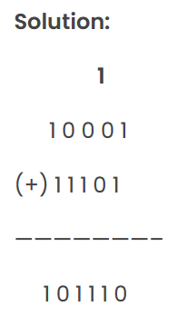
Binary addition

Slide 46

Binary addition

Slide 47
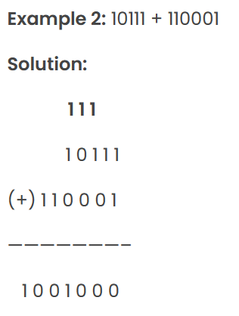
Binary addition

Slide 48
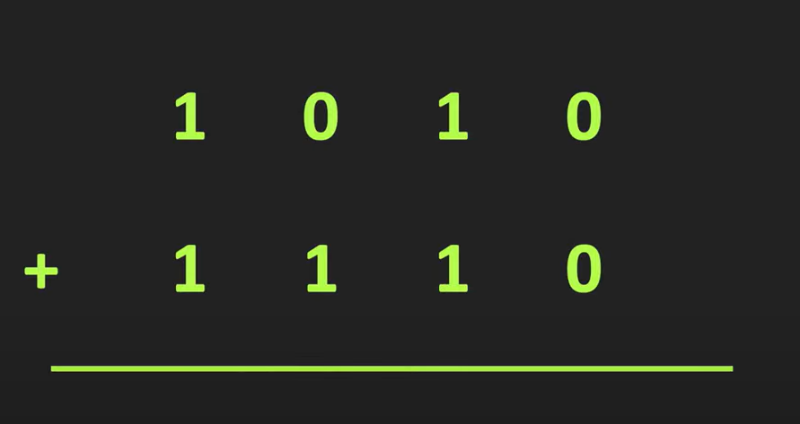
Binary addition

Slide 49
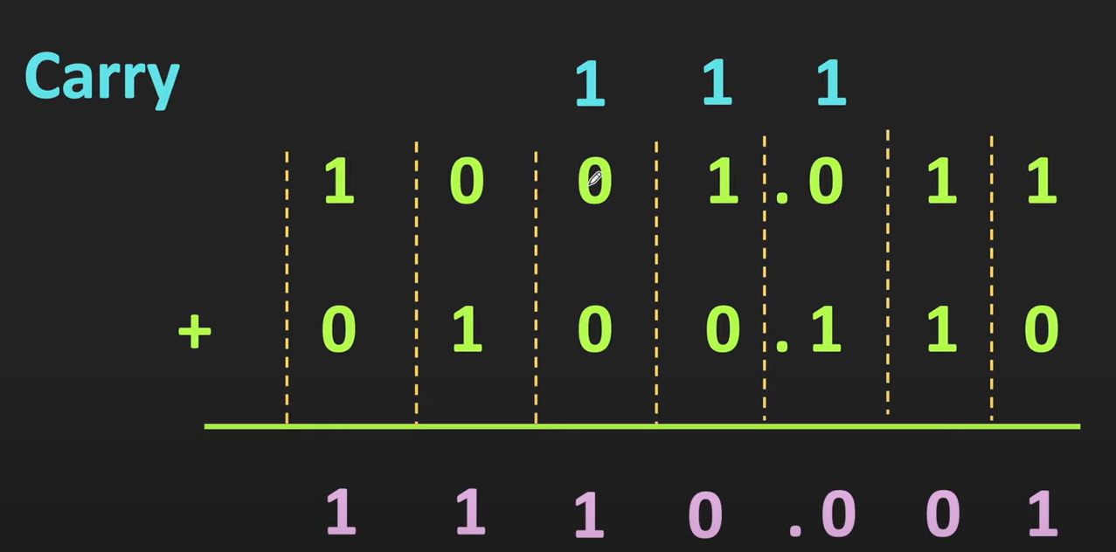
Binary Addition

Slide 50
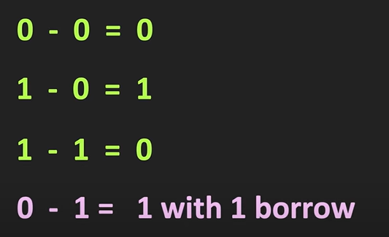
Binary subtraction
Rules:

Slide 51
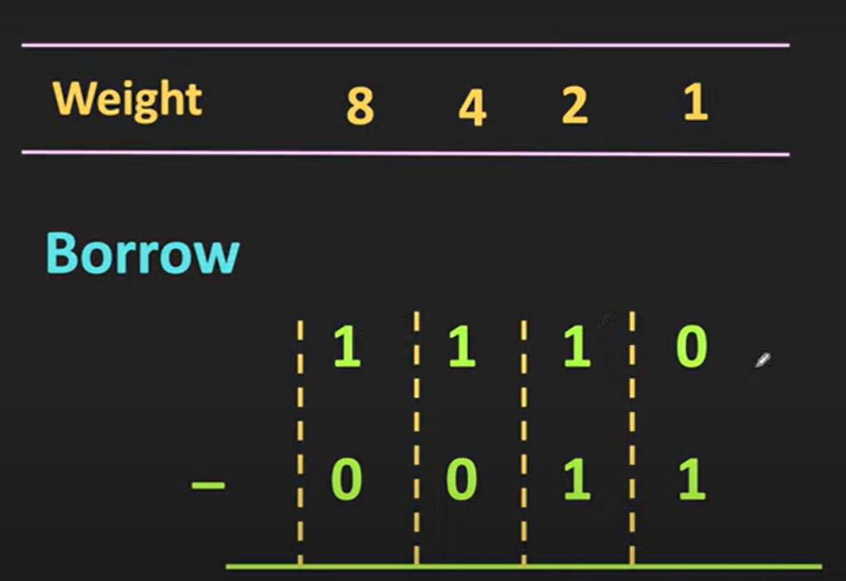
Binary subtraction
1 0 1 1

Slide 52
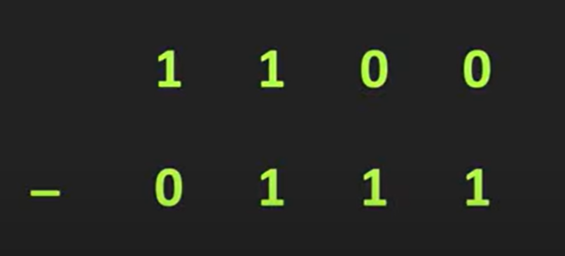
0 1 0 1

Slide 53
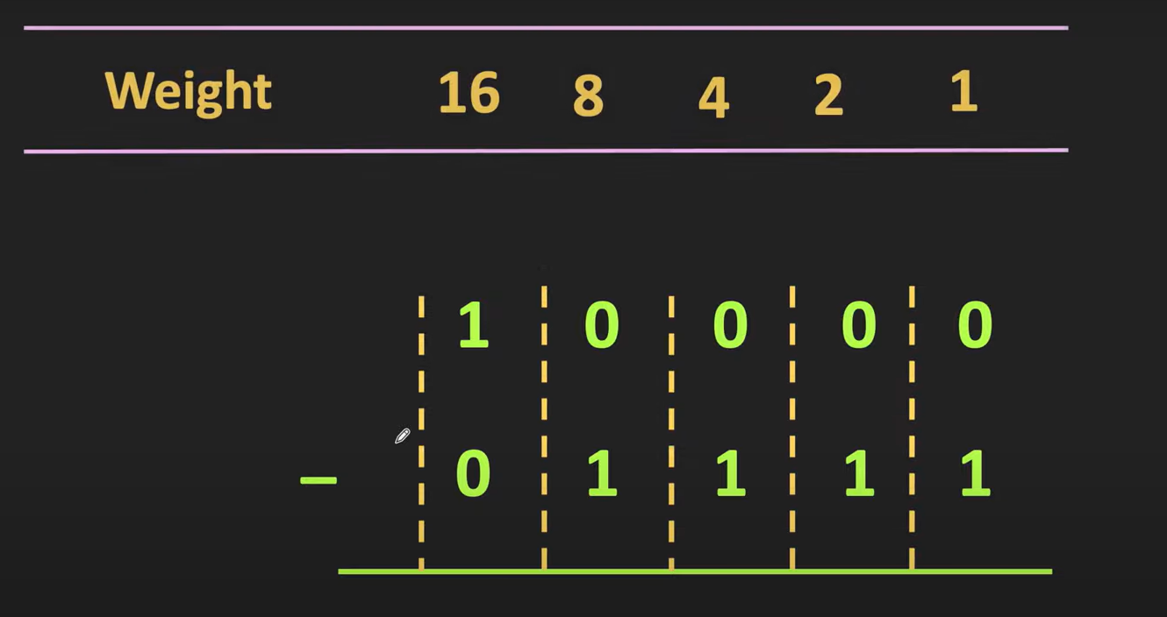
0 0 0 0 1

Slide 54
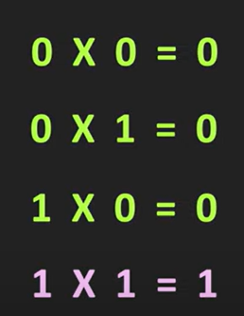
Binary multiplication
Rules:

Slide 55
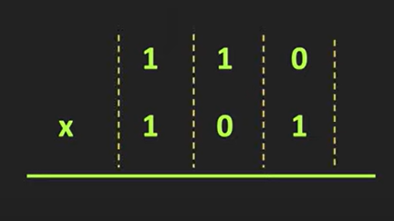
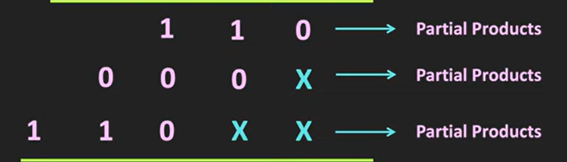
Binary multiplication
1 1 1 1 0

Slide 56
Binary division
101010 / 110
111
110
101010
110
1001
110
0110
110
0

Slide 57
Sign magnitude
Sign magnitude is represented using MSD.
If the number is positive, MSD is 0.
If the number is negative, MSD is 1.
Signed decimal | sign-magnitude
+6 | 0110
-6 | 1110
+0 | 0000
-0 | 1000
+7 | 0111
-7 | 1111

Slide 58
1’s complement
101010 ->
110110 - >
11100 ->

Slide 59
2’s complement
1’s complement + 1
101010 ->
110110 - >
11100 ->

Slide 60
101 <- (+5) First Number
+
011 <- (+3) Second Number
1000 <- (+8) Sum

Slide 61
1100 <- (-4) First number
+ 0010 <-(+2) Second Number
1110 <- (-2) Sum

Slide 62
Binary addition
While adding a numbers with same sign, just add and put the same sign.
If the numbers are of different sign, subtract the big number from small one and put the sign of the big one.

Slide 63
Binary addition using sign magnitude
Example 1:
Add + 7 and + 4
+ 7 -> 111
+4 -> 100
1011
1 is left as carry
MSD is 0, so the number is positive

Slide 64
Binary addition using sign magnitude
Example 2:
Add -7 and - 4
7 - > 111₂
4 -> 100₂
- 7 → 1’s complement of 7 + 1 -> 000+1 -> 001
- 4 → 1’s complement of 4 + 1 ->011+1 -> 100
0101
Remove the carry bit
MSD is 1, so the result is negative and take 2’s complement.

Slide 65
Binary addition using sign magnitude
Since MSD is 1, take 2’s complement.
2’s complement of 0101
-> 1010 + 1 = 01011 -> 11₁₀

Slide 66
Binary subtraction using sign magnitude
A-B => A + 2’S Complement of B
B-A => B + 2’s complement of A

Slide 67
Example 1:
Subtraction of 7 and 4
7 -> 111 +
2’s complement of 4 -> 100
011 3₁₀
* MSD=0 indicates that the resultant is positive.

Slide 68
Example 2:
Subtraction of 4 and 7
4 -> 100 +
-7 -> 001
101
MSD is 1, so the number is negative.
So take 2’s complement.
1’s complement of 101 → 010
2’s complement → 010+1 = 011 (3₁₀ )
Since, MSD is 1 result is -3₁₀

Slide 69
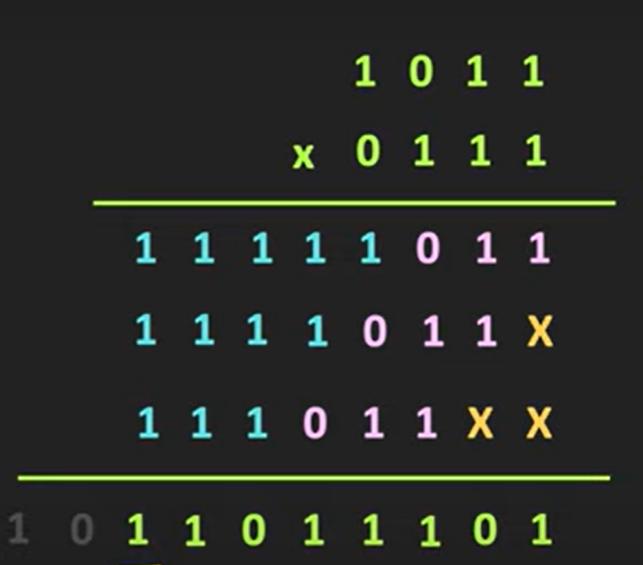
Binary multiplication

Slide 70
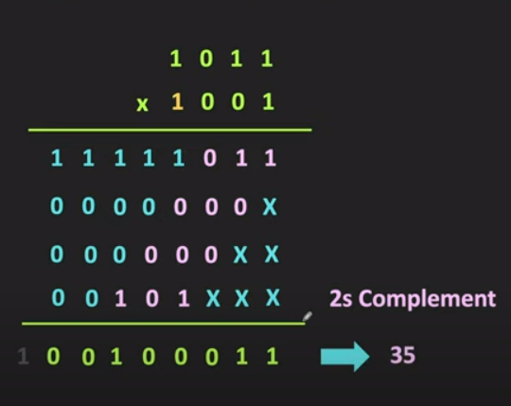
Binary multiplication

Slide 71
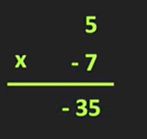
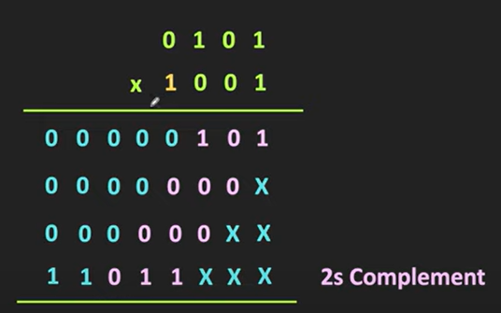
Example
1 1 0 1 1 1 1 0 1

Slide 72
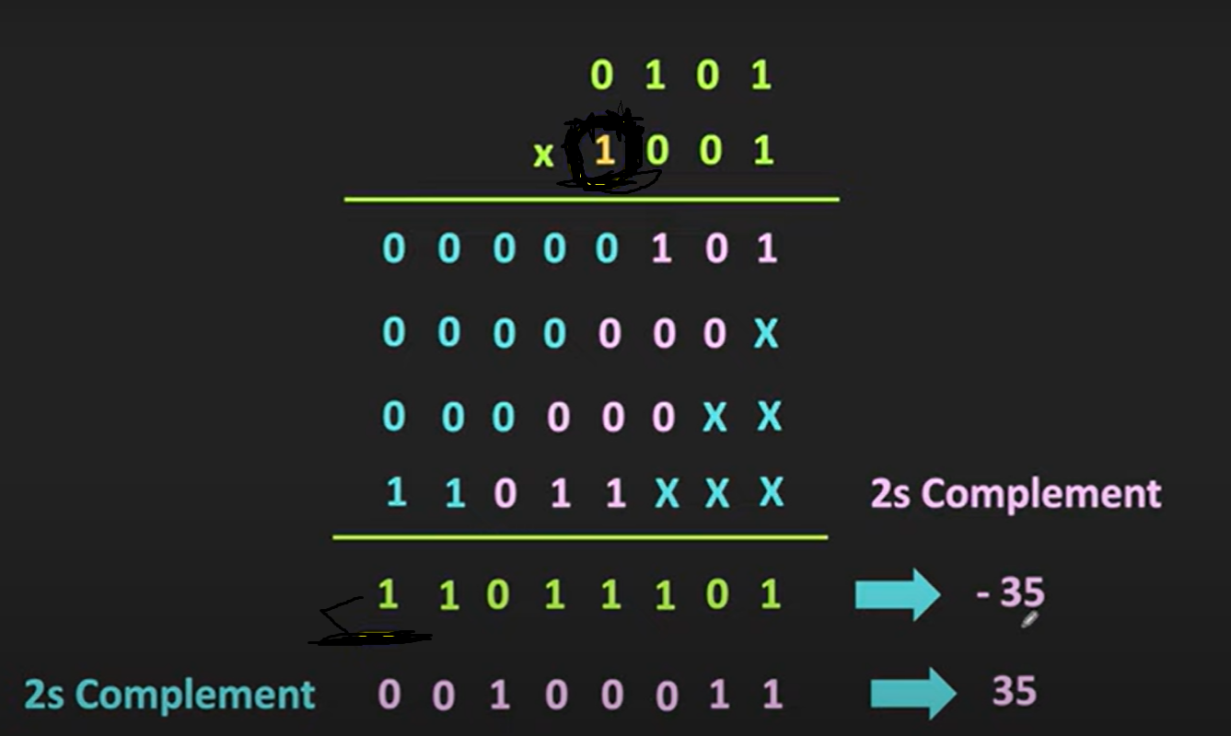
Example

Slide 73
Logic gates
Building block of digital circuits.
Make decisions based on a combination of digital signals coming from its inputs.
Logic gates are based on Boolean algebra.
False represents 0, and true represents 1.
Seven basic logic gates: AND, OR, XOR, NOT, NAND, NOR, and XNOR.

Slide 74

NOT gate
Also called as the inverter gate.
Has only one input.
It just inverts the input.
Input 1 | Result
1 | 0
0 | 1

Slide 75

AND gate
If both the inputs are true, the result is true else the result is false.
Input 1 | Input 2 | Result
1 | 1 | 1
1 | 0 | 0
0 | 1 | 0
0 | 0 | 0

Slide 76

NAND gate
AND gate followed by an inverter.
The output is false if both inputs are true.
Input 1 | Input 2 | Result
1 | 1 | 0
1 | 0 | 1
0 | 1 | 1
0 | 0 | 1

Slide 77

OR gate
If any one of the input is true, the result is true else the result is false.
Input 1 | Input 2 | Result
1 | 1 | 1
1 | 0 | 1
0 | 1 | 1
0 | 0 | 0

Slide 78

NOR gate
NOR gate followed by an inverter.
The output is true if both inputs are false.
Input 1 | Input 2 | Result
1 | 1 | 0
1 | 0 | 0
0 | 1 | 0
0 | 0 | 1

Slide 79

XOR gate (eXclusive OR)
If either one of the input is true, the result is true else the result is false.
If both the inputs are same, the result is false.
Input 1 | Input 2 | Result
1 | 1 | 0
1 | 0 | 1
0 | 1 | 1
0 | 0 | 0

Slide 80
eXclusive NOR (XNOR) gate
XOR gate followed by an inverter.
The output is true if both inputs are same.
Input 1 | Input 2 | Result
1 | 1 | 1
1 | 0 | 0
0 | 1 | 0
0 | 0 | 1

